Slide 1
M.S. Ramaiah Institute of Technology
(Autonomous Institute, Affiliated to VTU)
Department of CSE (AIML) and CSE (Cyber Security)
Course Name: Database Management Systems Course Code: CI32 Credits: 3:0:1 UNIT 3
Reference:
Abraham Silberschatz, Henry F Korth, S. Sudarshan
Database System Concepts (7th Edition)

Slide 2
Introduction to SQL
SQL stands for Structured Query Language.
Although SQL language is referred to as a “query language”, the language can be used to do much more than querying from a database.
SQL can be used to
define the structure of the data in the database,
modify the data in the database, and
specify security constraints for the data in the database.
Many implementations of the SQL differ in details or support only a subset of the full language.
SQL (Structured Query Language) is a standardized programming language used for managing and manipulating relational databases.
Prepared By reshma Rachel cherish, Department of CSE (ai&ml) and CSE (Cyber security)
Slide 1- 2

Slide 3










Introduction to SQL (contd.)
Various database management systems (DBMS) implement SQL with slight variations, optimizations, and additional features.
Different implementations often align with the same basic principles of SQL but may offer unique syntax, functionality, and capabilities.
Some of the most widely used SQL implementations are:
My SQL 7. IBM Db2
PostgreSQL 8. Amazon Aurora
Microsoft SQL Server (T-SQL) 9. Google Cloud SQL
Oracle Database (PL/SQL) 10. CockroachDB
SQLite
MariaDB
Prepared By reshma Rachel cherish, Department of CSE (ai&ml) and CSE (Cyber security)
Slide 1- 3

Slide 4
Unit III
Overview of the SQL Query Language
SQL Data Definition – Basic Types, Basic Schema Definition
Basic structure of SQL Queries – Queries on single relation and multiple relations
Additional Basic Operations – Rename, String, attribute specification, ordering display of tuples
Set Operations – Union, Intersect, Except
Null Values
Aggregate Functions – Basic Aggregation, Aggregation with Grouping, The Having Clause, Aggregation with Null and Boolean values
Nested Subqueries
Modification of the Database
Join Expressions
Views
Transactions
Integrity Constraints
SQL Data Types and Schemas
Prepared By reshma Rachel cherish, Department of CSE (ai&ml) and CSE (Cyber security)
4

Slide 5
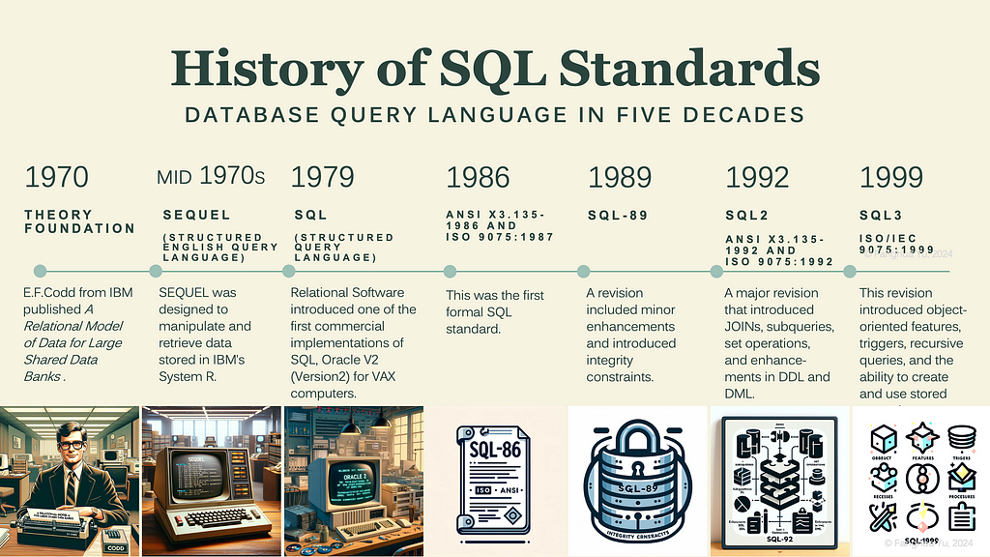
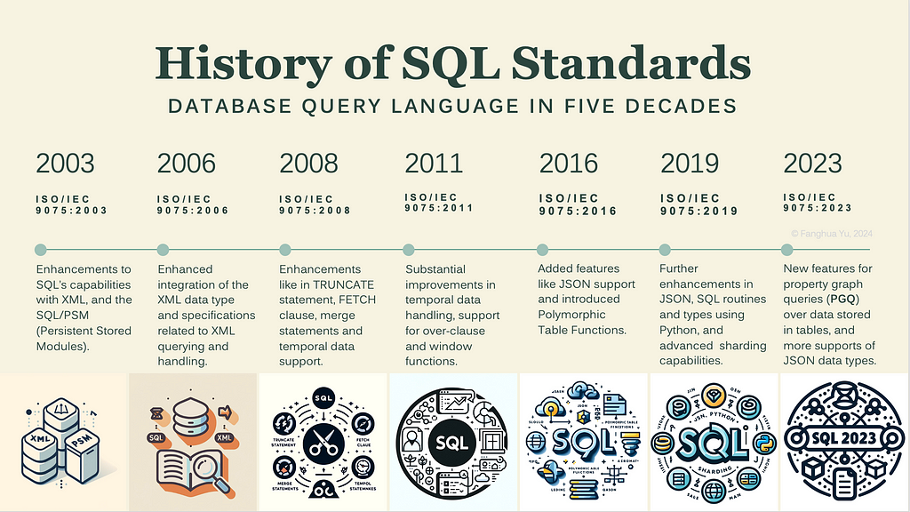
OVERVIEW OF SQL QUERY LANGUAGE(1)
IBM developed the original version of SQL, originally called Sequel, as part of the System R project in the early 1970s.
The Sequel language has evolved since then, and its name has changed to SQL (Structured Query Language) – a standard relational database language.
Prepared By reshma Rachel cherish, Department of CSE (ai&ml) and CSE (Cyber security)
5

Slide 6
OVERVIEW OF SQL QUERY LANGUAGE(1)
SQL language has several parts:
Data-definition language (DDL) - provides commands for defining relation schemas, deleting relations, and modifying relation schemas
Data-manipulation language (DML) - provides the ability to query information from the database and to insert tuples into, delete tuples from, and modify tuples in the database
Integrity – DDL includes commands for specifying integrity constraints that the data stored in the database must satisfy. Updates that violate integrity constraints are disallowed.
View definition - DDL includes commands for defining views
Transaction control - commands for specifying the beginning and ending of transactions.
Embedded SQL and dynamic SQL - define how SQL statements can be embedded within general-purpose programming languages, such as C, C++, and Java
Authorization - DDL includes commands for specifying access rights to relations and views.
Prepared By reshma Rachel cherish, Department of CSE (ai&ml) and CSE (Cyber security)
6

Slide 7
SQL DATA DEFINITION (2)
DATA DEFINITION LANGUAGE (DDL) – used to specify a set of relations in a database to the database management system.
SQL DDL allows the specification of not only a set of relations, but also information about each relation.
Information about each relation includes:
Relational schema - Schema for each relation
Attribute values - Types of values associated with each attribute
Integrity constraints (Attribute constraints/relation constraints) – rules that apply to the relationships between tables (or relations) and rules that apply to the values stored in a column (attribute)
Set of indices for each relation – allowing for faster searches, inserts, updates, and deletes; indices are created on one or more columns of a relation
Security and Authorization information for each relation - database administrators to enforce access control rules, ensuring data confidentiality, integrity, and availability – done using ACCESS CONTROL, PRIVILEGES, AND ROLES – GRANT keyword
Physical storage structure of each relation on disk - how the database engine stores the data of that relation on disk – DATA FILES, PAGES (BLOCKS), RECORDS, HEAPS
Prepared By reshma Rachel cherish, Department of CSE (ai&ml) and CSE (Cyber security)
7

Slide 8
Basic Types
char(n) - A fixed-length character string with user-specified length ‘n’ that specifies the exact length of the string in characters. This datatype reserves exactly n bytes of storage for each value. The database will pad the string with spaces if a string is shorter than n characters. It can contain letters, numbers, and special characters.
varchar(n) - A variable-length character string with user-specified maximum length ‘n’. This datatype will only store the actual string length and does not pad with spaces.
int - An integer (a finite subset of the integers that is machine-dependent). It is used to store whole numbers (both positive and negative) without decimal points.
smallint - A small integer (a machine-dependent subset of the integer type).
numeric(p, d) – A fixed-point number with user-specified precision. The number consists of p digits (plus a sign), and the d of the p digits is to the right of the decimal point.
real, double precision - Floating-point and double-precision floating-point numbers with machine-dependent precision.
Prepared By reshma Rachel cherish, Department of CSE (ai&ml) and CSE (Cyber security)
Notes:
8

Slide 9
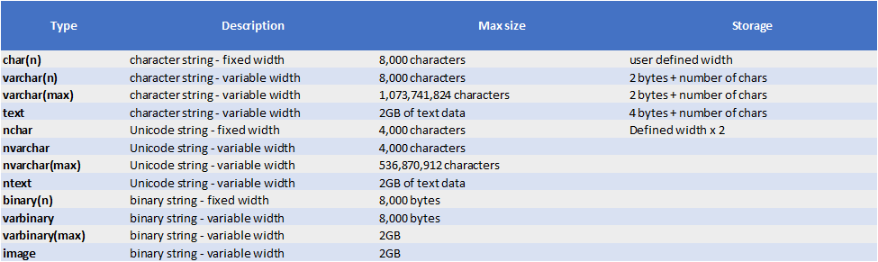
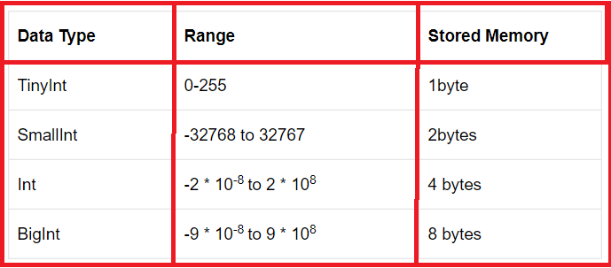
Basic Types
float(n) - A floating-point number, with a precision of at least ‘n’ digits.
Each type may include a special value called the null value, indicating an absent value.
Prepared By reshma Rachel cherish, Department of CSE (ai&ml) and CSE (Cyber security)
Notes:
9

Slide 10
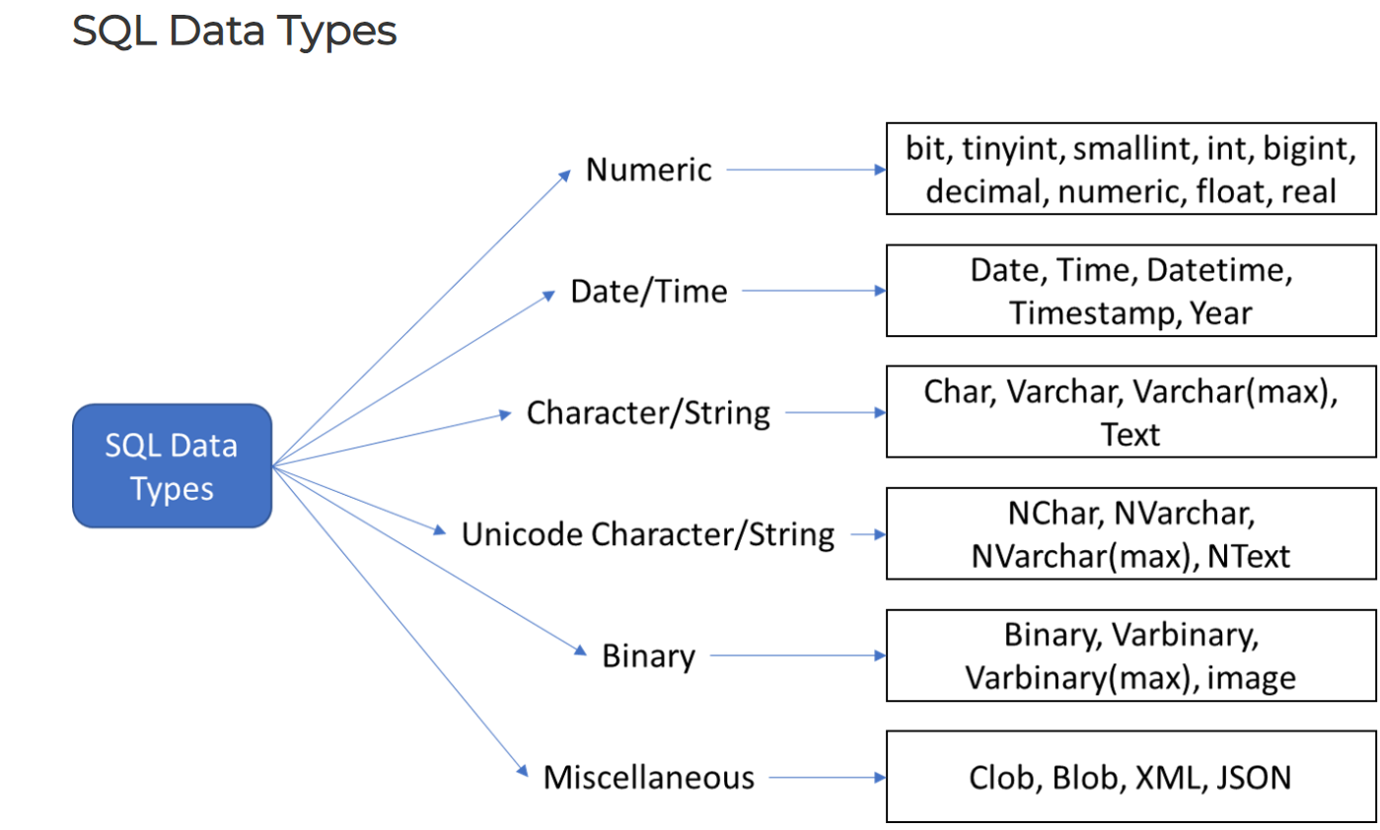
Basic Types
Prepared By reshma Rachel cherish, Department of CSE (ai&ml) and CSE (Cyber security)
Notes:
10

Slide 11
Basic Schema Definition
Relational Schema and Attribute values: An SQL relation is defined by using the create table command.
Table Creation: The general form of the create table command is:
create table r
(A1 D1,
A2 D2,
. . . ,
An Dn,
<integrity-constraint1>,
. . . , <integrity-constraintk>);
where
r is the name of the relation,
each Ai is the name of an attribute in the schema of relation r,
Di is the domain of attribute Ai (Di specifies the type of attribute Ai along with optional constraints that restrict the set of allowed values for Ai).
; is used to indicate the end of the create table statements
Prepared By reshma Rachel cherish, Department of CSE (ai&ml) and CSE (Cyber security)
Notes:
11

Slide 12
Basic Schema Definition
Integrity constraints (Attribute constraints/relation constraints): SQL supports a number of different integrity constraints.
Primary Key – The primary-key specification says that attributes Aj1 , Aj2, . . . , Ajm form the primary key for the relation
The primary key attributes are required to be non-null and unique
No tuple can have a null value for a primary-key attribute
No two tuples in the relation can be equal on all the primary-key attributes
Foreign Key – The foreign key specification says that the values of attributes (Ak1 , Ak2, . . . , Akn ) for any tuple in the relation must correspond to values of the primary key attributes of some tuple in relation s.
Not Null – The not null constraint on an attribute specifies that the null value is not allowed for that attribute
Prepared By reshma Rachel cherish, Department of CSE (ai&ml) and CSE (Cyber security)
Notes:
12

Slide 13
Basic Schema Definition
What will happen if the constraints specified for a table are violated?
SQL prevents any update or modification to the database that violates an integrity constraint.
Example:
For Updation: If a newly inserted or modified tuple in a relation has null values for any primary-key attribute, or if the tuple has the same value on the primary-key attributes as does another tuple in the relation, SQL flags an error and prevents the update.
For Insertion: an insertion of a course tuple with a dept name value that does not appear in the department relation would violate the foreign-key constraint on course, and SQL prevents such an insertion from taking place.
Prepared By reshma Rachel cherish, Department of CSE (ai&ml) and CSE (Cyber security)
13

Slide 14
Basic Schema Definition
Inserting records/tuple or row creation for a relation:
A newly created relation is empty initially.
Insertion Syntax: The general form of the create table command is:
insert into r values (V1, V2 V3, ….,Vn);
where ‘r’ is the name of the relation and V1, V2, V3 are the attribute values.
The insert command is used to load data into the relation.
Example: To add an instructor named Smith in the Biology department with instructor id 10211 and a salary of $66,000, the query will be
insert into instructor values (10211, ’Smith’, ’Biology’, 66000);
The values are specified in the order in which the corresponding attributes are listed in the relation schema
Prepared By reshma Rachel cherish, Department of CSE (ai&ml) and CSE (Cyber security)
14

Slide 15
Basic Schema Definition
Deleting records/tuple or row creation from a relation:
the delete command is used to delete tuples from a relation.
Deletion Syntax: The general form of the delete command is:
delete from r;
where ‘r’ is the name of the relation
The above delete command is used to delete all tuples/rows/records from a relation.
Example: To add an instructor named Smith in the Biology department with instructor id 10211 and a salary of $66,000, the query will be
insert into instructor values (10211, ’Smith’, ’Biology’, 66000);
The values are specified in the order in which the corresponding attributes are listed in the relation schema
Prepared By reshma Rachel cherish, Department of CSE (ai&ml) and CSE (Cyber security)
15

Slide 16
Basic Schema Definition
To remove a relation from SQL database:
The drop table command is used to remove the relation or table from the database.
Deletion Syntax: The general form of the delete command is:
drop table r;
where ‘r’ is the name of the relation
The above command deletes not only all tuples of r, but also the schema for r. After r is dropped, no tuples can be inserted into r unless it is re-created with the create table command.
To add attributes to an existing relation:
The alter table command is used to add attributes to an existing relation.
All tuples in the relation are assigned null as the value for the new attribute.
Prepared By reshma Rachel cherish, Department of CSE (ai&ml) and CSE (Cyber security)
16

Slide 17
Basic Schema Definition
ALTER Syntax:
The general form of the ALTER command to add attributes is:
alter table r add A D;
where ‘r’ is the name of the existing relation,
A is the name of the attribute to be added, and
D is the type of the added attribute.
The general form of the ALTER command to drop attributes is:
alter table r drop A;
where ‘r’ is the name of the existing relation,
A is the name of the attribute to be dropped.
Prepared By reshma Rachel cherish, Department of CSE (ai&ml) and CSE (Cyber security)
17

Slide 18
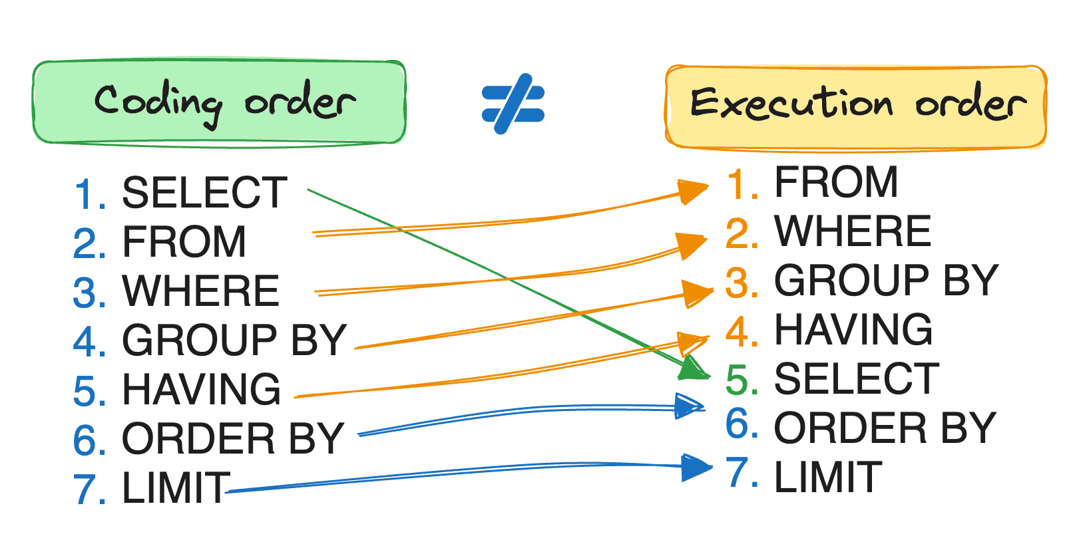
BASIC STRUCTURE OF SQL QUERIES(3)
The basic structure of an SQL query consists of 3 clauses:
select clause – used to list the attributes desired in the result of a query.
from clause – is a list of the relations to be accessed in the evaluation of the query.
where clause – is a predicate involving attributes of the relation in the from clause.
Clauses must be written in the following order in an SQL query.
SELECT – Returns the final data
FROM – choose and join tables to get the base data
WHERE – Filters the base data
GROUP BY – Aggregates the base data
HAVING – Filters the aggregated data
ORDER BY – Sorts the final data
Prepared By reshma Rachel cherish, Department of CSE (ai&ml) and CSE (Cyber security)
18

Slide 19
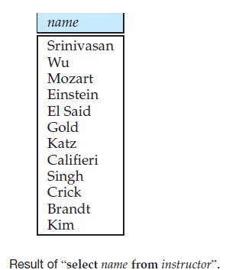
Queries on a Single Relation
SELECT clause
Example 1: Consider a University database,
Ask? suppose we want to “Find the names of all instructors.”
Given: Instructor names are found in the instructor relation.
So, in this scenario,
the instructor’s name is available in the NAME attribute. So, this NAME attribute is used along with the SELECT clause.
the NAME attribute is available in the INSTRUCTOR relation. So, this INSTRUCTOR relation is used along with the FROM clause.
So, the select query for this scenario will be written as select name from instructor;
The result is a relation consisting of a single attribute with the heading name.
Prepared By reshma Rachel cherish, Department of CSE (ai&ml) and CSE (Cyber security)
Notes:
19

Slide 20
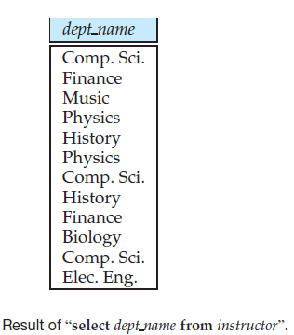
Queries on a Single Relation
Example 2: Consider a University database,
Ask? suppose we want to “Find the department names of all instructors”
So, in this scenario, the select query will be written as select dept_name from instructor;
Inferences: More than one instructor can belong to one department
A department name could appear more than once in the instructor relation
Prepared By reshma Rachel cherish, Department of CSE (ai&ml) and CSE (Cyber security)
Notes:
20

Slide 21
Queries on a Single Relation
DISTINCT keyword - to force the elimination of duplicates, we insert the keyword distinct after select. So, the above query can be rewritten as
select distinct dept_name from instructor;
The result of the above rewritten query would contain each department name at most once.
ALL keyword – use this keyword to specify explicitly that duplicates are not removed.
select all dept_name from instructor;
SELECT with arithmetic expressions (with operators +, −, ∗, and /) – Example consider the query,
select ID, name, dept name, salary * 1.1 from instructor;
Prepared By reshma Rachel cherish, Department of CSE (ai&ml) and CSE (Cyber security)
Notes:
21

Slide 22
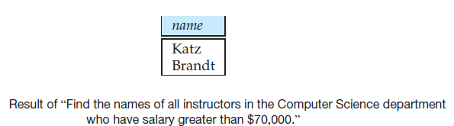
Queries on a Single Relation
where clause
It allows us to select only those rows in the result relation of the from clause that satisfy a specified predicate.
Example 3: “Find the names of all instructors in the Computer Science department who have salary greater than $70,000.”
So, the query can be written as
select name from instructor where dept name = ’Comp. Sci.’ AND salary > 70000;
where clause along with logical connectives AND, OR, and NOT
The operands of the logical connectives can be expressions involving the comparison operators <, <=, >, >=, =, and <>.
Prepared By reshma Rachel cherish, Department of CSE (ai&ml) and CSE (Cyber security)
Notes:
22

Slide 23
Queries on Multiple Relations
General Syntax:
select A1, A2, . . . , An
from r1, r2, . . . , rm
where P;
Each A_{i} represents an attribute, where i ranges from 1 to n
Each r_{i} a relation, where i ranges from 1 to m
P is a predicate (the criteria or condition to be applied on the attribute/attribute values of the relation).
Prepared By reshma Rachel cherish, Department of CSE (ai&ml) and CSE (Cyber security)
Notes:
23

Slide 24
Queries on Multiple Relations
Example 4: “Retrieve the names of all instructors, along with their department names and department building name.”
Instructor relation schema - the department name is got from the attribute dept name
Department relation schema – the department building name is got from the attribute building
To answer the above query, each tuple in the instructor relation must be matched with the tuple in the department relation whose dept name value matches the dept_name value of the instructor tuple.
So, the query is written as,
select name, instructor.dept name, building
from instructor, department
where instructor.dept_name = department.dept_name;
Prepared By reshma Rachel cherish, Department of CSE (ai&ml) and CSE (Cyber security)
Notes:
24

Slide 25
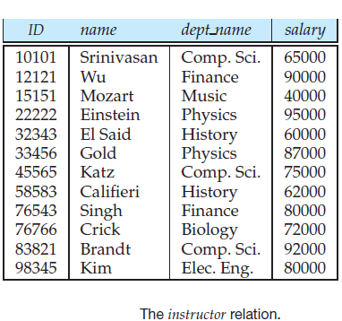
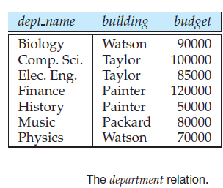
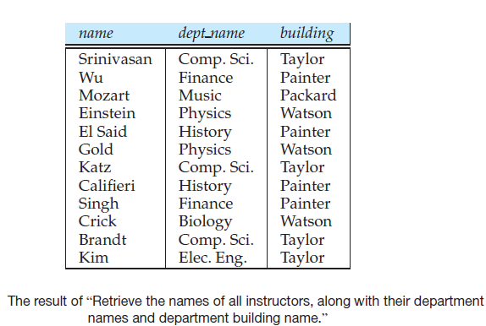
Queries on Multiple Relations
Prepared By reshma Rachel cherish, Department of CSE (ai&ml) and CSE (Cyber security)
Notes:
25

Slide 26
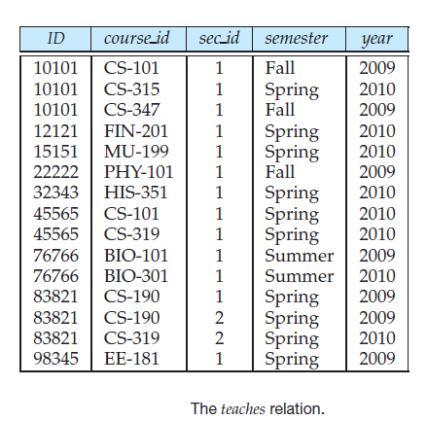
Queries on Multiple Relations
Example 5: The relation schema for the cartesian product of the relations instructor and teaches is:
(instructor.ID, instructor.name, instructor.dept name, instructor.salary
teaches.ID, teaches.course id, teaches.sec id, teaches.semester, teaches.year)
Prepared By reshma Rachel cherish, Department of CSE (ai&ml) and CSE (Cyber security)
Notes:
26

Slide 27
Queries on Multiple Relations
Example 6: We can drop the relation-name prefix for those attributes that appear in only one of the two schemas.
We can rewrite the relation schema as: (instructor.ID, name, dept_name, salary, teaches.ID, course_id, sec_id, semester, year)
Prepared By reshma Rachel cherish, Department of CSE (ai&ml) and CSE (Cyber security)
Notes:
27

Slide 28
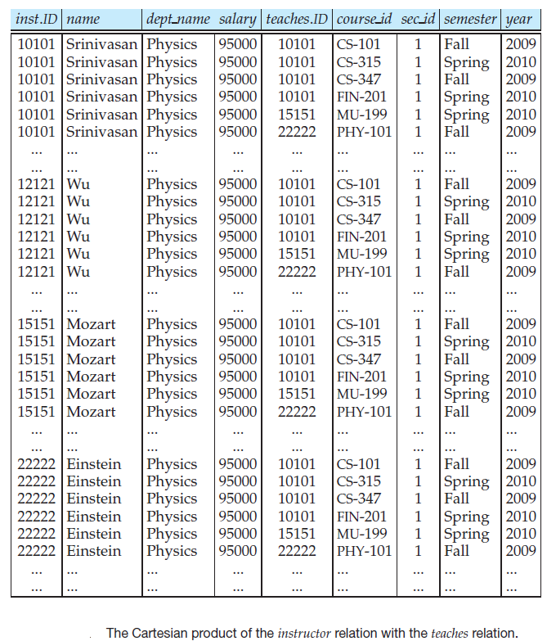
Queries on Multiple Relations
Prepared By reshma Rachel cherish, Department of CSE (ai&ml) and CSE (Cyber security)
Notes:
28

Slide 29
Queries on Multiple Relations
The Cartesian product by itself combines tuples from instructor and teaches that are unrelated to each other.
Each tuple in instructor is combined with every tuple in teaches, even those that refer to a different instructor. The result can be an extremely large relation, and creating such a cartesian product rarely makes sense.
How to restrict the non-meaningful combinations created by the cartesian product?
By using the predicate in the WHERE clause. Consider the below query, I can rewrite the SQL query as below:
“All instructors in the university who have taught some course, find their names and the course ID of all courses they taught”.
SELECT name, course_id
FROM instructor, teaches
WHERE instructor.ID = teaches.ID;
Prepared By reshma Rachel cherish, Department of CSE (ai&ml) and CSE (Cyber security)
Notes:
29

Slide 30
ADDITIONAL BASIC OPERATIONS (4)
The RENAME Operation: Consider the query
SELECT name, course_id
FROM instructor, teaches
WHERE instructor.ID = teaches.ID;
The result of this query is a relation with the attributes: name, course_id
Why should we go for the rename operation?
When two relations in the from clause may have attributes with the same name, the attribute name is duplicated in the result.
When an arithmetic expression is used in the select clause, the resultant attribute does not have a name.
Simply, making a choice to select another name for the attribute names derived from the existing relation.
Prepared By reshma Rachel cherish, Department of CSE (ai&ml) and CSE (Cyber security)
30

Slide 31

ADDITIONAL BASIC OPERATIONS (4)
The RENAME Operation:
SQL uses the as clause to rename the attributes of a result relation.
Form: <old-name> as <new-name>
where <old-name> = name of the attribute in the base relation
<new-name> = new name to be assigned for the attribute in the result relation
Note: The “as” clause can be used for both the select and from clauses (meaning it can be used to rename the attribute names as well as the relation or table names)
Prepared By reshma Rachel cherish, Department of CSE (ai&ml) and CSE (Cyber security)
31

Slide 32



ADDITIONAL BASIC OPERATIONS (4)
The RENAME Operation:
Using the “as” clause to rename the name of a table or relation is referred to as CORRELATION NAME or TABLE ALIAS or CORRELATION VARIABLE or a TUPLE VARIABLE.
Ask?
“Find the names of all instructors whose salary is greater than at least one instructor in the Biology department.”
Prepared By reshma Rachel cherish, Department of CSE (ai&ml) and CSE (Cyber security)
32

Slide 33
ADDITIONAL BASIC OPERATIONS (4)
The STRING Operations:
SQL specifies strings by enclosing them in single quotes
Consider the scenario of having a single quote character in a string expression.
Eg: ‘It’s right’. How will you specify it as part of a string operation in SQL?
‘It”s right’
Note : Every single quote character that is part of a string can be specified by using two single quote characters
The Equality operation on strings is case sensitive. Eg: ‘Computer Science’ is not equal to ‘computer science’ or ‘comp. sci.’ is not equal to ‘Comp. Sci.’
Note : However this default behaviour can be changed either at the database level or at the level of specific attributes.
Prepared By reshma Rachel cherish, Department of CSE (ai&ml) and CSE (Cyber security)
33

Slide 34
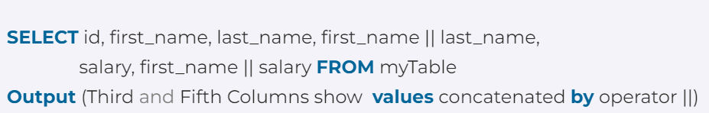
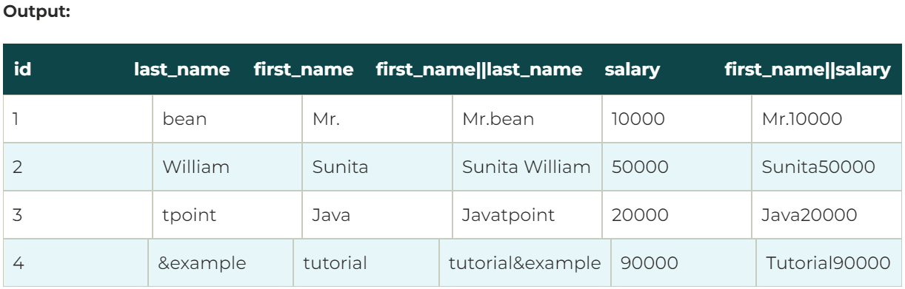
ADDITIONAL BASIC OPERATIONS (4)
The STRING Operations:
STRING Functions: SQL also permits a variety of functions on character strings.
Concatenation - This function merges two or more words or strings. This is done using “||”.
Prepared By reshma Rachel cherish, Department of CSE (ai&ml) and CSE (Cyber security)
34

Slide 35
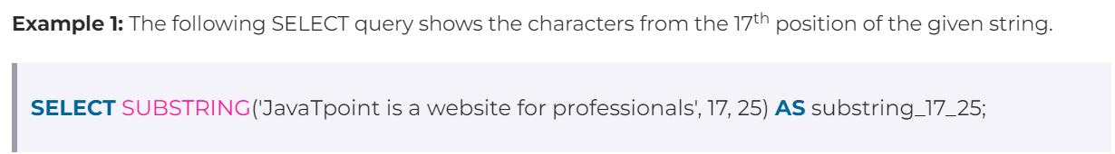
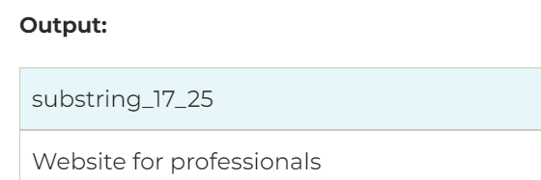
ADDITIONAL BASIC OPERATIONS (4)
The STRING Operations:
STRING Functions: SQL also permits a variety of functions on character strings.
2. Extracting substrings – shows the characters or sub-string from the specific index value of the original string
Prepared By reshma Rachel cherish, Department of CSE (ai&ml) and CSE (Cyber security)
35

Slide 36
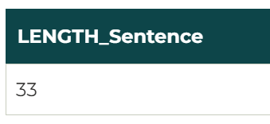
ADDITIONAL BASIC OPERATIONS (4)
The STRING Operations:
STRING Functions: SQL also permits a variety of functions on character strings.
3. Finding length of strings – returns the number of characters of the given string or word.
Prepared By reshma Rachel cherish, Department of CSE (ai&ml) and CSE (Cyber security)
36

Slide 37
ADDITIONAL BASIC OPERATIONS (4)
The STRING Operations:
STRING Functions: SQL also permits a variety of functions on character strings.
4. upper(s) – Converts the string specified to uppercase where ‘s’ is the string.
5. lower(s) – Converts the string specified to lowercase where ‘s’ is the string.
6. trim(s) - removes spaces at the end of a string.
Pattern Matching in Strings - Pattern matching can be performed on strings, using the operator like. Patterns are case-sensitive; that is, uppercase characters do not match lowercase characters, or vice versa.
Patterns are specified by using two special characters:
Percent (%): The % character matches any substring.
Underscore (_): The character matches any character.
Prepared By reshma Rachel cherish, Department of CSE (ai&ml) and CSE (Cyber security)
37

Slide 38
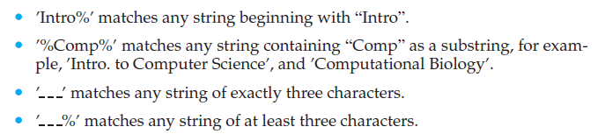

ADDITIONAL BASIC OPERATIONS (4)
The STRING Operations:
Pattern Matching in Strings
Examples:
Now, consider the query, “Find the names of all departments whose building name includes the substring ‘Watson’.” This query can be written as:
Prepared By reshma Rachel cherish, Department of CSE (ai&ml) and CSE (Cyber security)
38

Slide 39

ADDITIONAL BASIC OPERATIONS (4)
The STRING Operations:
Pattern Matching in Strings
For patterns to include the special pattern characters (i.e., % and _), SQL allows the specification of an escape character.
The escape character is used immediately before a special pattern character to indicate that the special pattern character is to be treated like a normal character.
The escape character for a like comparison is defined using the escape keyword.
not like - to search for mismatches in a string
Prepared By reshma Rachel cherish, Department of CSE (ai&ml) and CSE (Cyber security)
39

Slide 40

ADDITIONAL BASIC OPERATIONS (4)
Attribute Specification in SELECT clause:
(*) symbol in the select clause is used to denote that all attributes needs to be selected.
Ordering the display of tuples:
SQL offers the user some control over the order in which tuples in a relation are displayed.
The order by clause causes the tuples in the result of a query to appear in sorted order.
The order by clause can be used along with the keywords, ASC or DESC to specify the sort order. By default, if no keyword is specified, then the ordering takes place in ascending order.
Prepared By reshma Rachel cherish, Department of CSE (ai&ml) and CSE (Cyber security)
40

Slide 41


ADDITIONAL BASIC OPERATIONS (4)
Ordering the display of tuples :
For example, “To list in alphabetic order all instructors in the Physic department,
Suppose that we wish to list the entire instructor relation in descending order of salary, and if many instructors have the same salary, we order the instructor records in ascending order by name
Prepared By reshma Rachel cherish, Department of CSE (ai&ml) and CSE (Cyber security)
41

Slide 42

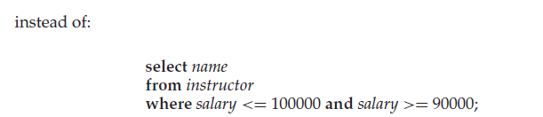

ADDITIONAL BASIC OPERATIONS (4)
WHERE clause predicates:
between comparison operator: to specify that a value be less than or equal to some value and greater than or equal to some other value.
For example, “To find the names of instructors with salary amounts between $90,000 and $100,000,
For example, “To find the names of instructors and courses, they taught for all instructors in the Biology department who have taught some course.”
not between comparison operator: this operator can be used as a negation to the “between” operator
Prepared By reshma Rachel cherish, Department of CSE (ai&ml) and CSE (Cyber security)
42

Slide 43

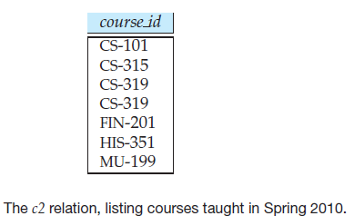

SET OPERATIONS (5)
UNION, INTERSECT, EXPECT: These SQL operations works on relations and corresponds to the mathematical set-theory operations ∪, ∩, and −.
For example, “To find the set of all courses taught in the Fall 2009 semester,
For example, “To find the set of all courses taught in the Spring 2010 semester”
Prepared By reshma Rachel cherish, Department of CSE (ai&ml) and CSE (Cyber security)
43

Slide 44
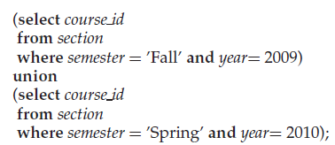
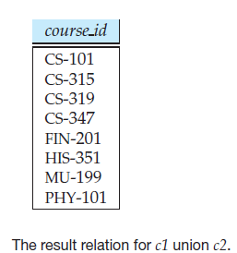
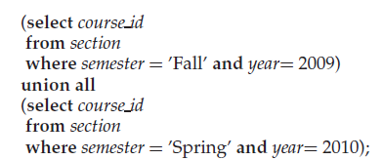
SET OPERATIONS (5)
UNION Operation:
For example, “To find the set of all courses taught either in Fall 2009 or in Spring 2010, or both, we write
The union operation automatically eliminates duplicates.
If we want to retain all duplicates, we must write union all in place of union:
Prepared By reshma Rachel cherish, Department of CSE (ai&ml) and CSE (Cyber security)
44

Slide 45
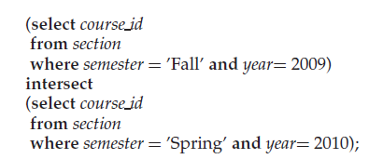
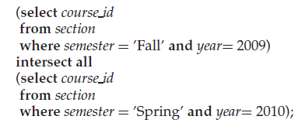
SET OPERATIONS (5)
INTERSECT Operation:
For example, “To find the set of all courses taught in the Fall 2009 as well as in Spring 2010, we write
The intersect operation automatically eliminates duplicates.
If we want to retain all duplicates, we must write intersect all in place of intersect:
Prepared By reshma Rachel cherish, Department of CSE (ai&ml) and CSE (Cyber security)
45

Slide 46
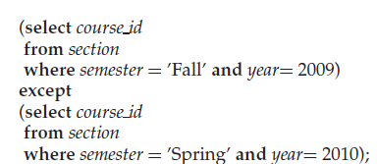
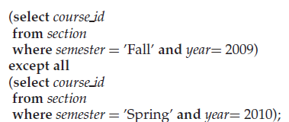
SET OPERATIONS (5)
EXCEPT Operation:
For example, “To find all courses taught in the Fall 2009 semester but not in the Spring 2010 semester, we write
The except operation outputs all tuples from its first input that do not occur in the second input. It performs set difference.
If we want to retain all duplicates, we must write except all in place of except:
Prepared By reshma Rachel cherish, Department of CSE (ai&ml) and CSE (Cyber security)
46

Slide 47
NULL VALUES (6)
NULL Values:
Null values in relational operations, include arithmetic operations, comparison operations, and set operations.
The result of an arithmetic expression (involving, for example, +, −, ∗, or /) is NULL if any of the input values is null.
Example consider the comparison, “1 < NULL”. This expression can neither be evaluated Thus, “TRUE” nor “FALSE”. This is because we are not sure of what the NULL value holds.
Note: SQL therefore treats as UNKNOWN the result of any comparison involving a NULL value.
Thus, a third logical value UNKNOWN is created in addition to TRUE and FALSE.
The value “UNKNOWN” is dealt with the Boolean operations such as AND, OR, and NOT on the result of comparisons in a WHERE clause predicate.
Prepared By reshma Rachel cherish, Department of CSE (ai&ml) and CSE (Cyber security)
47

Slide 48
NULL VALUES (6)
NULL Values: Results of Boolean operations along with UNKNOWN values is given as below:
If the where clause predicate evaluates to either FALSE or UNKNOWN for a tuple, that tuple is not added to the result.
BOOLEAN OPERATIONS | Value 1 | Value 2 | Result
AND | TRUE | UNKNOWN | UNKNOWN
 | FALSE | UNKNOWN | FALSE
 | UNKNOWN | UNKNOWN | UNKNOWN
OR | TRUE | UNKNOWN | TRUE
 | FALSE | UNKNOWN | UNKNOWN
 | UNKNOWN | UNKNOWN | UNKNOWN
NOT |  | UNKNOWN | UNKNOWN
Prepared By reshma Rachel cherish, Department of CSE (ai&ml) and CSE (Cyber security)
48

Slide 49

NULL VALUES (6)
NULL Values: (Special Keywords)
SQL uses the special keyword null in a predicate to test for a null value. The result of using all the of below is a BOOLEAN value (True or False).
is null - This returns a Boolean value TRUE if the value on which it is applied is a null value.
is not null – This returns a Boolean value TRUE if the value on which it is applied is not a null value.
SQL uses the is unknown and is not unknown clauses to test whether the result of a comparison is UNKNOWN.
Prepared By reshma Rachel cherish, Department of CSE (ai&ml) and CSE (Cyber security)
49

Slide 50
AGGREGATE FUNCTIONS(7)
Aggregation Functions:
Functions that take a collection (a set or multiset) of values as input and returns a single value.
SQL offers 5 standard built-in aggregate functions:
Average : avg()
Minimum : min()
Maximum : max()
Total: sum()
Count: count()
The input to sum and avg must be a collection of numbers.
The input to max and min can be a collection of non-numeric data types such as strings.
Prepared By reshma Rachel cherish, Department of CSE (ai&ml) and CSE (Cyber security)
50

Slide 51
AGGREGATE FUNCTIONS(7)
Basic Aggregation:
Functions that take a collection (a set or multiset) of values as input and returns a single value.
SQL offers 5 standard built-in aggregate functions:
Average : avg()
Minimum : min()
Maximum : max()
Total: sum()
Count: count() - count the number of tuples in a relation
The input to sum and avg must be a collection of numbers.
The input to max and min can be a collection of non-numeric data types such as strings.
Prepared By reshma Rachel cherish, Department of CSE (ai&ml) and CSE (Cyber security)
51

Slide 52


AGGREGATE FUNCTIONS(7)
Basic Aggregation:
Find the average salary of instructors in the Computer Science department
The database system may give an arbitrary name to the result relation attribute that is generated by aggregation; however, we can give a meaningful name to the attribute by using the as clause as follows:
Prepared By reshma Rachel cherish, Department of CSE (ai&ml) and CSE (Cyber security)
52

Slide 53
AGGREGATE FUNCTIONS(7)
Basic Aggregation:
The importance of the usage of the distinct keyword in front of the attribute name is dependent on the example and the kind of attribute included as part of the attribute.
Example, the salaries in the Computer Science department are $75,000, $65,000, and $92,000. The average balance is $232,000/3 = $77,333.33.
Retaining duplicates is important in computing an average. Suppose the Computer Science department adds a fourth instructor whose salary happens to be $75,000. If duplicates were eliminated, we would obtain the wrong answer ($232,000/4 = $58.000) rather than the correct answer of $76,750.
If we do want to eliminate duplicates, we use the keyword distinct in the aggregate expression.
Prepared By reshma Rachel cherish, Department of CSE (ai&ml) and CSE (Cyber security)
53

Slide 54


AGGREGATE FUNCTIONS(7)
Basic Aggregation:
For example, Find the total number of instructors who teach a course in the Spring 2010 semester
For example, to find the number of tuples in the course relation
Prepared By reshma Rachel cherish, Department of CSE (ai&ml) and CSE (Cyber security)
54

